Slide 1
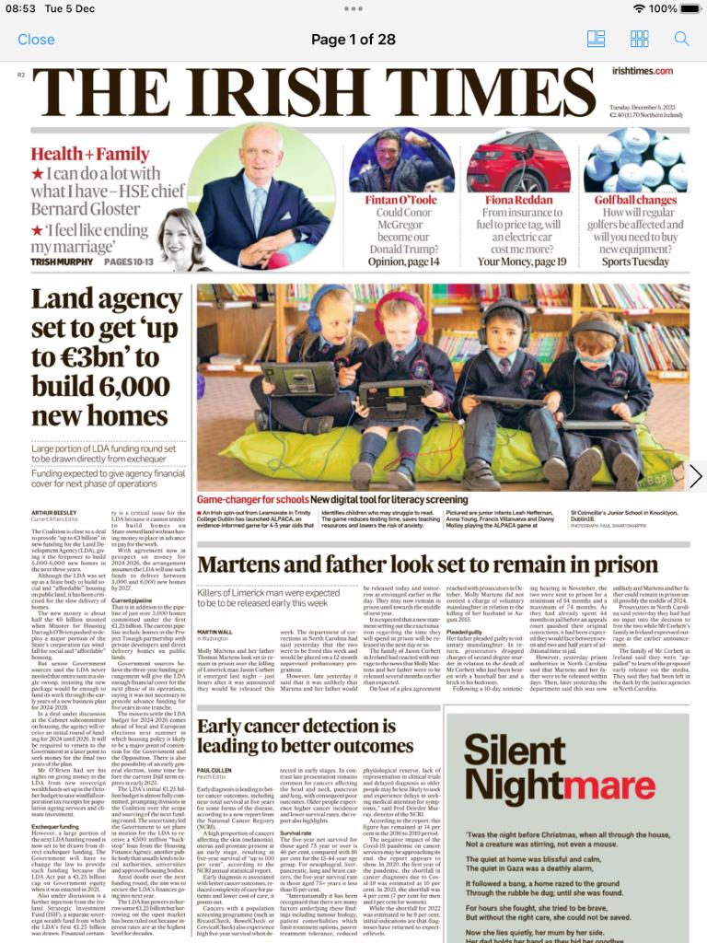
Front Cover Irish Times
5th December 2023

Slide 2

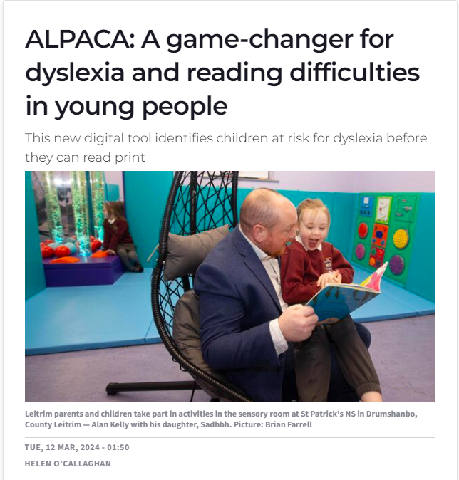
12th March 2024 – Full Page Parenting Section
https://www.irishexaminer.com/lifestyle/parenting/arid-41350666.html

Slide 3
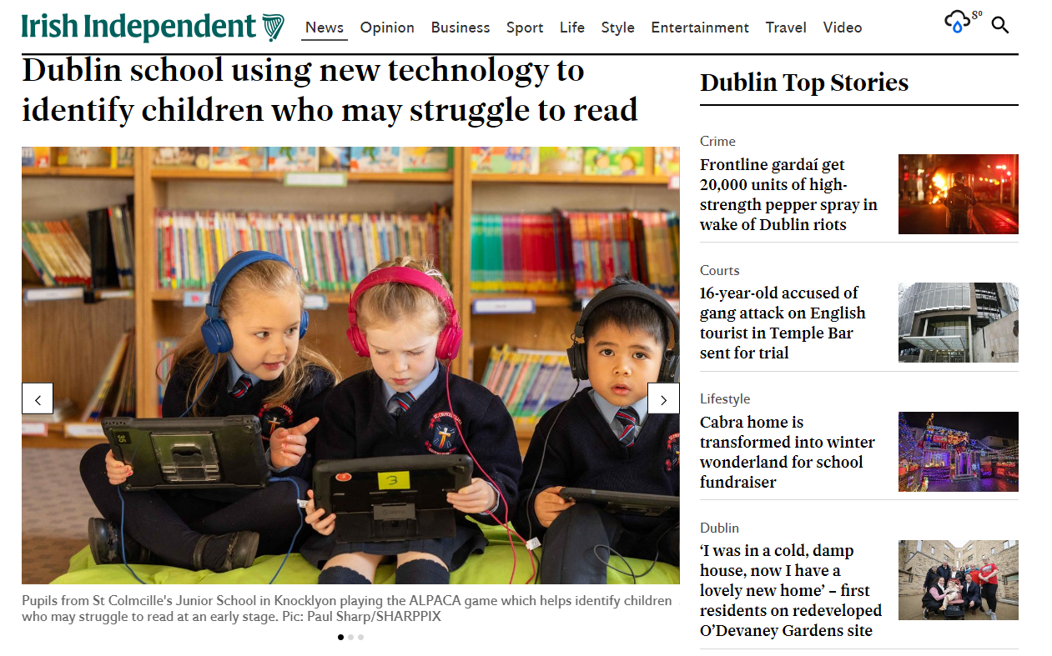
https://www.independent.ie/regionals/dublin/dublin-news/dublin-school-using-new-technology-to-identify-children-who-may-struggle-to-read/a329217814.html

Slide 4
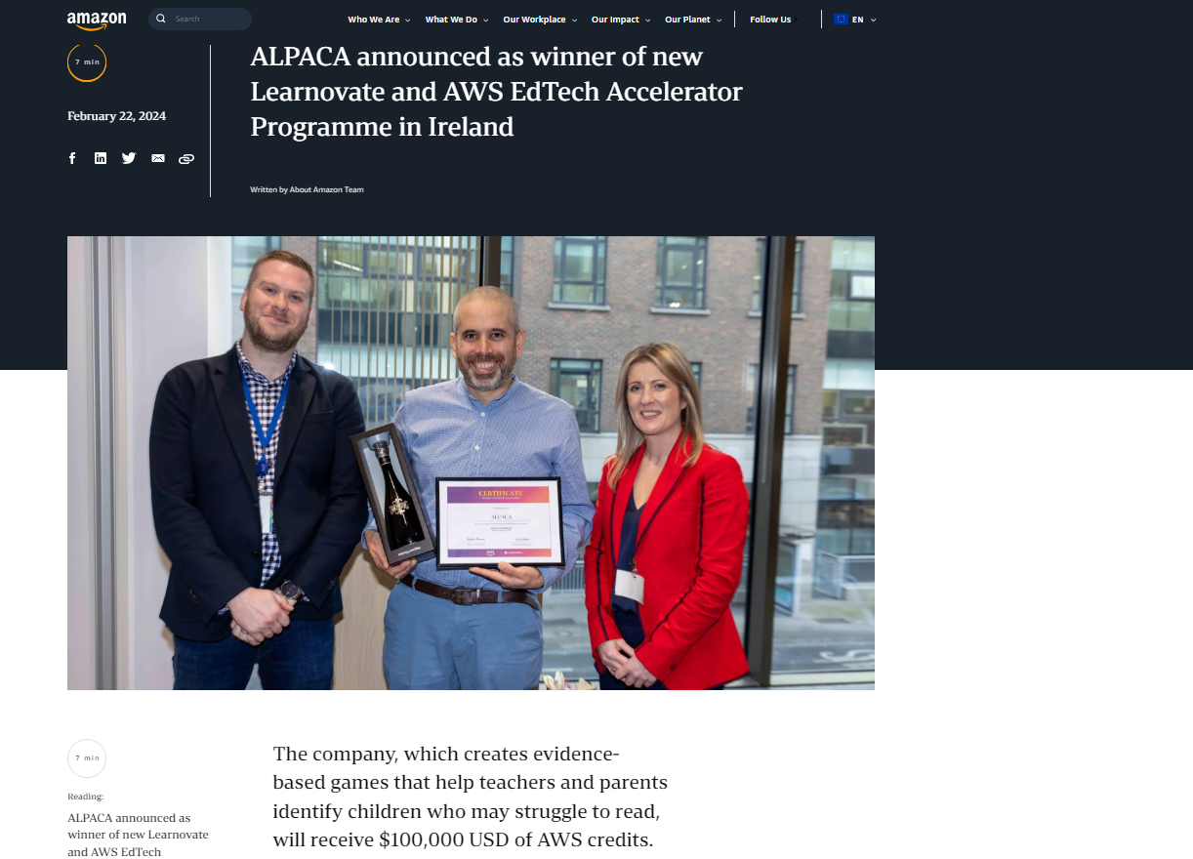
https://www.aboutamazon.eu/news/aws/alpaca-announced-as-winner-of-new-learnovate-and-aws-edtech-accelerator-programme-in-ireland

Slide 5
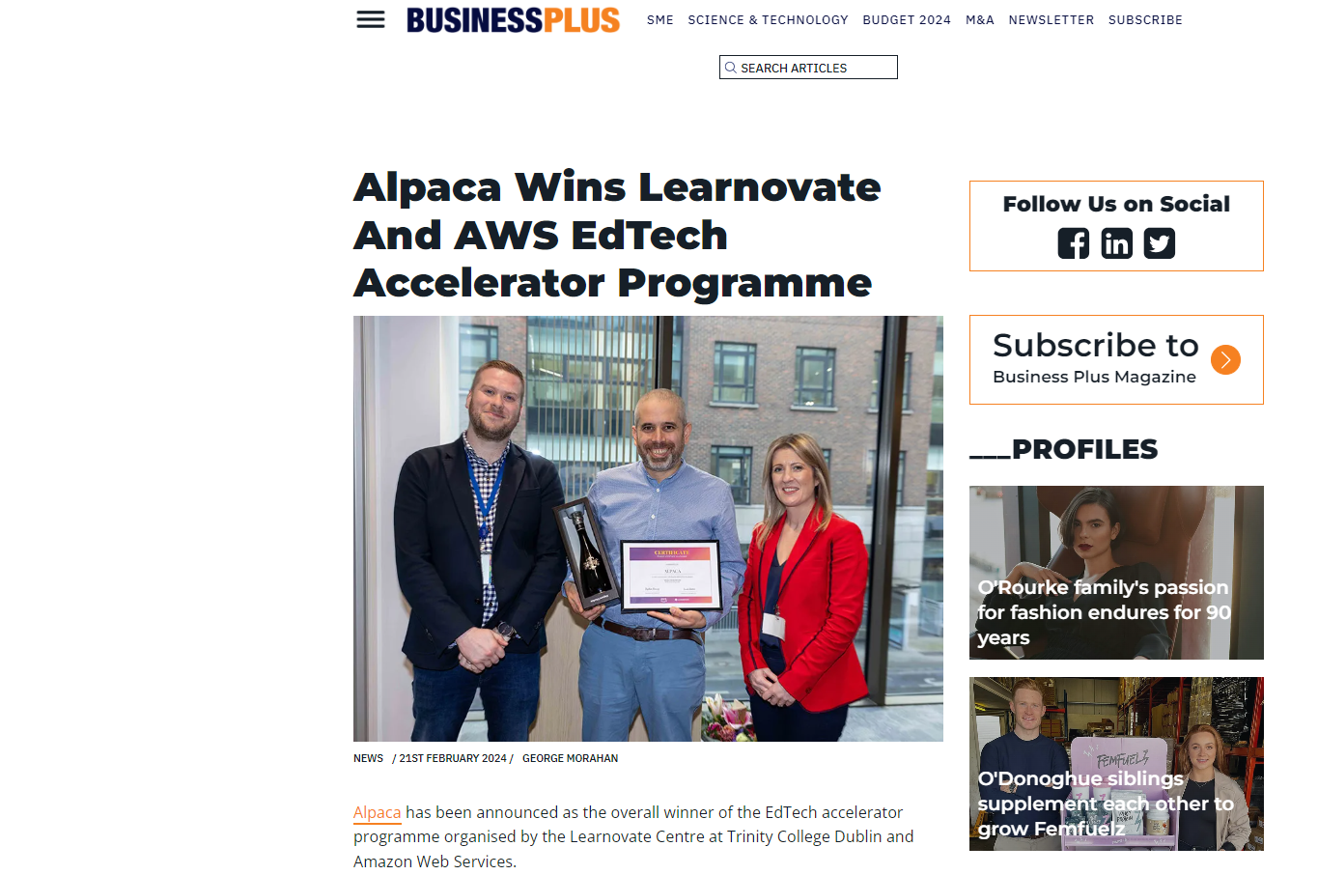
https://businessplus.ie/news/alpaca-learnovate-aws-1/

Slide 6
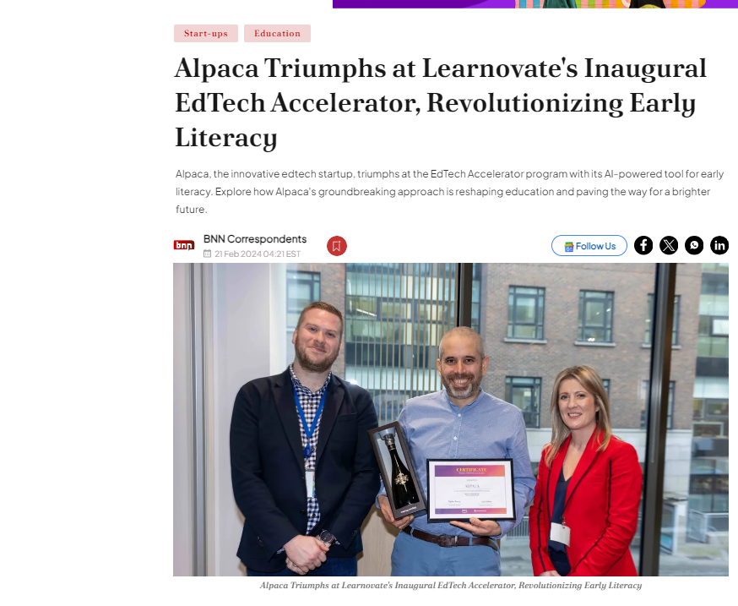
BreakingNewsNetwork
India
https://bnnbreaking.com/tech/start-ups/alpaca-triumphs-at-learnovates-inaugural-edtech-accelerator-revolutionizing-early-literacy

Slide 7
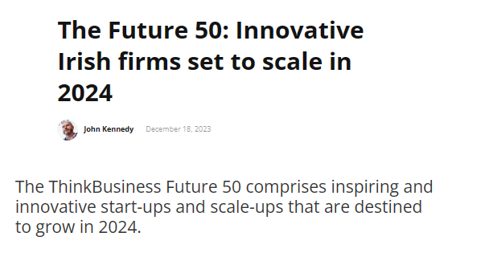

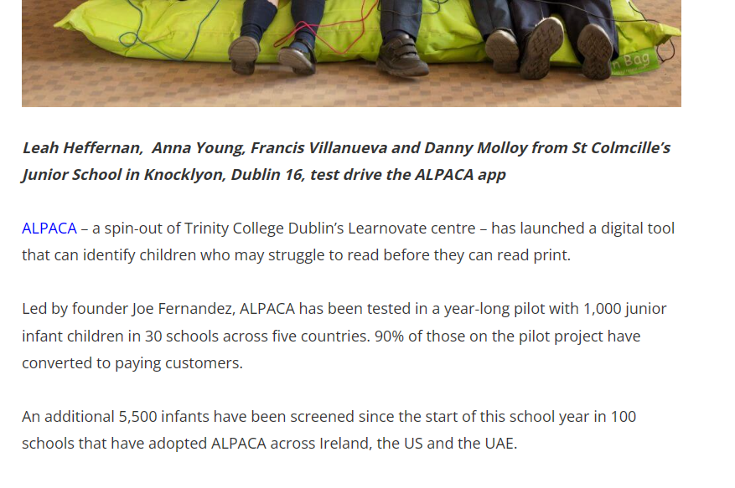
The Future 50: Firms set to scale in 2024 | ThinkBusiness

Slide 8
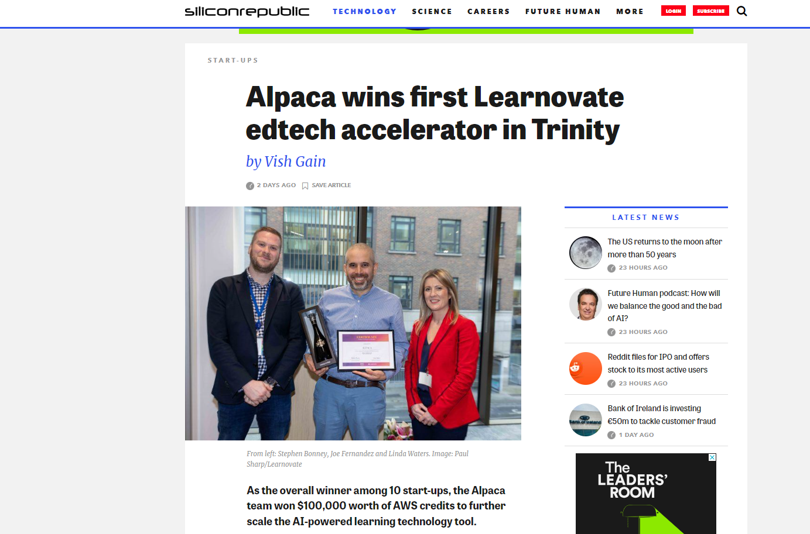
https://www.siliconrepublic.com/start-ups/alpaca-learnovate-edtech-accelerator-winner-trinity-detect-reading-issues

Slide 9
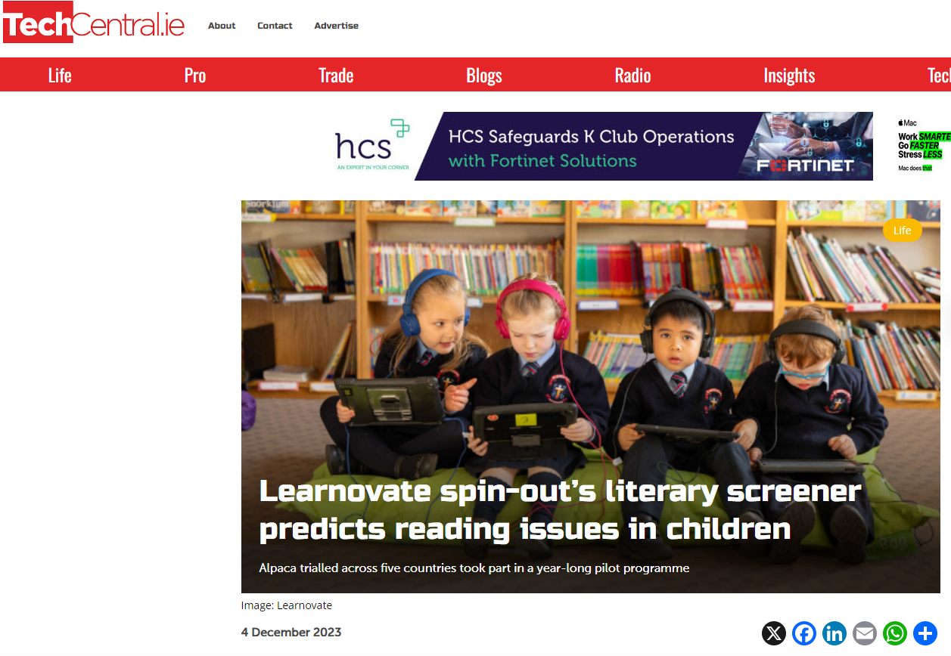
https://www.techcentral.ie/learnovate-spin-outs-literary-screener-predicts-reading-issues-in-children/

Slide 10
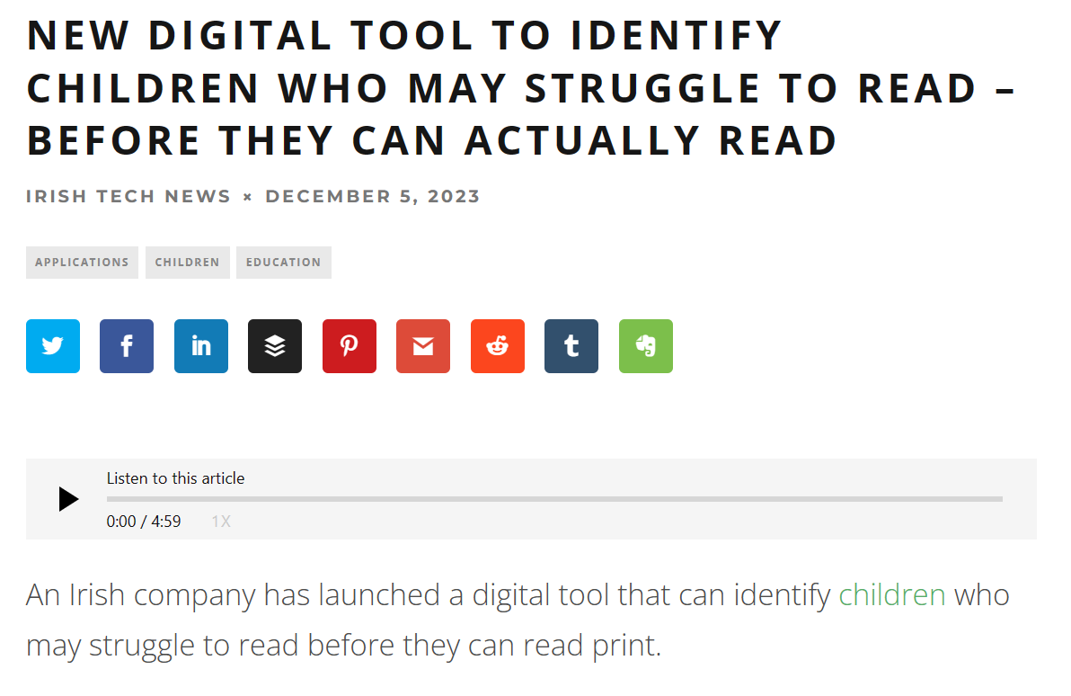
New Digital Tool to Identify Children Who May Struggle to Read - Before They Can Actually Read - Irish Tech News

Slide 11
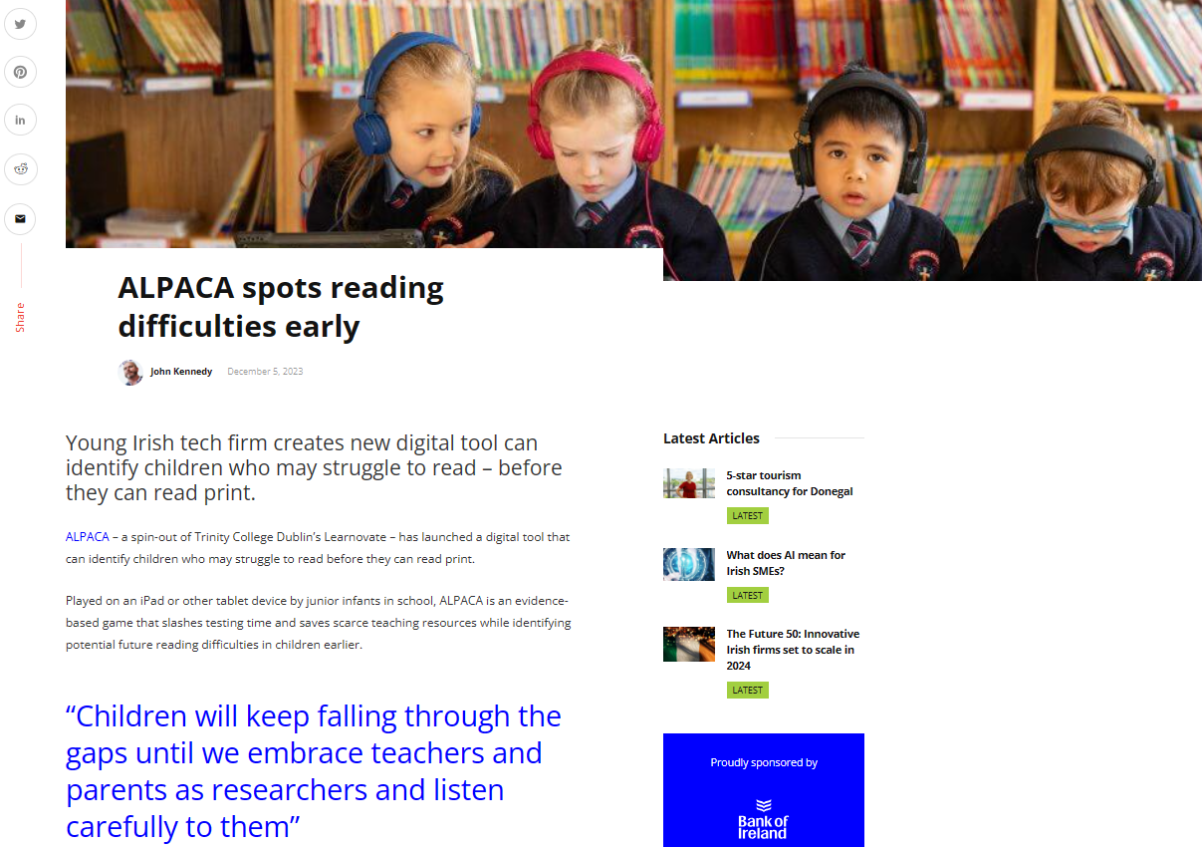
ALPACA spots reading difficulties early | ThinkBusiness

Slide 12

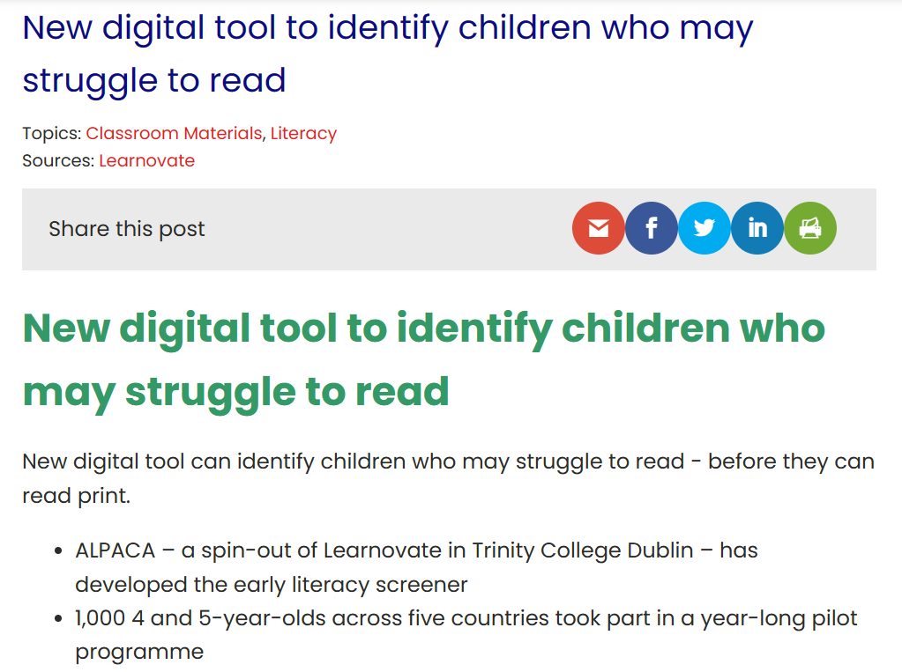
New digital tool to identify children who may struggle to read - Careers and Education News (careersnews.ie)

Slide 13
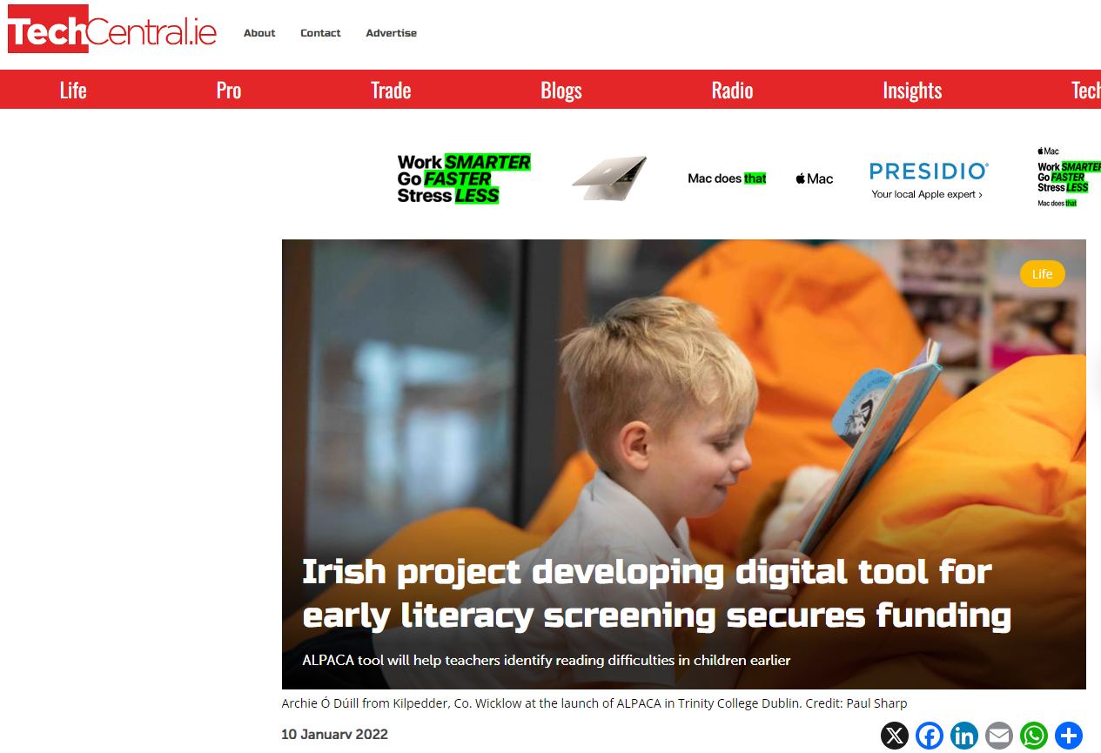
https://www.techcentral.ie/irish-project-developing-digital-tool-for-early-literacy-screening-secures-funding/

Slide 14
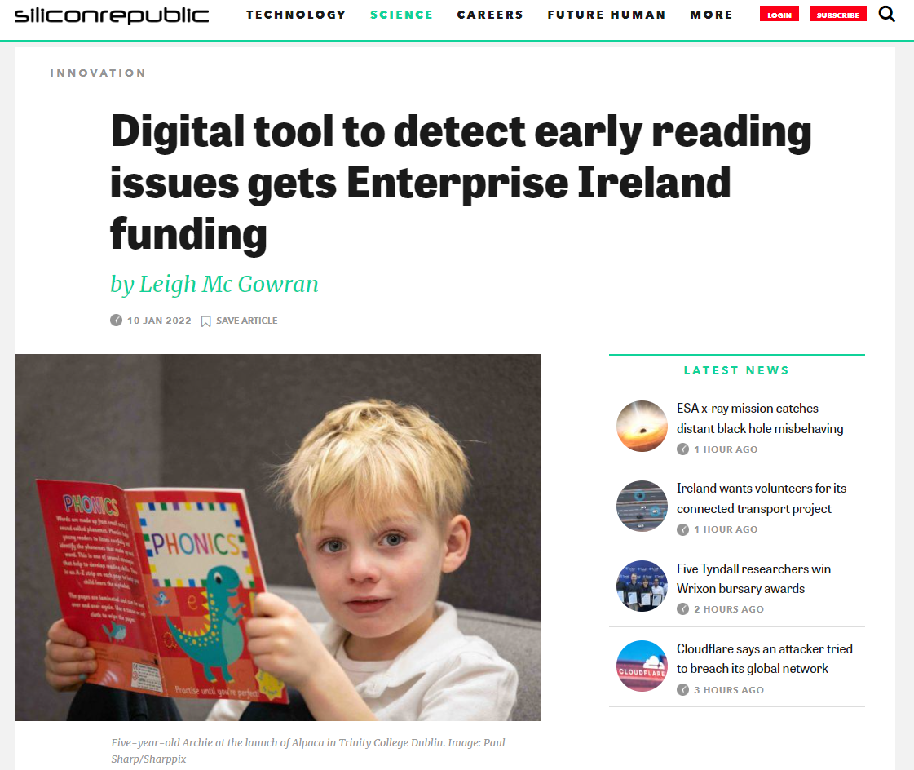
https://www.siliconrepublic.com/innovation/enterprise-ireland-funding-digital-reading-alpaca

